Slide 1
Gokaraju Rangaraju Institute of Engineering and Technology (Autonomous) Department of Computer Science and Engineering GR18A3116 –Major Project with Seminar IV Year B.Tech I Sem. Academic year 2021-2022
FINAL PPT
on
Fake Review Detection Using Machine Learning
1

Slide 2
INTRODUCTION
Reviews are increasing in popularity on social websites and thus there are no means to verify which content generated by the user is believable or which source is reliable. The consequences of spread of such misinformation are negative and it causes harm to user as well as businesses. The main purpose is to provide analysis of the main review that have been proposed to detect fake reviews, in particular approaches that employ machine learning techniques. The review detection sites such as Yelp can be considered while detecting fake review detection. The supervised machine learning techniques consider distinct features generated from the reviews written by a reviewer. A publicly available large Scale and generated dataset has been considered provided by amazon through Kaggle. It contains reviews which are classified using few well known supervised classifiers which bifurcate the reviews as true or deceptive by considering various features of the data. Using this, we will perform analysis using Machine Learning Algorithms to get a trained model capable of detecting a legitimate review from a fake one with good accuracy.
2

Slide 3

ABSTRACT
Online reviews can play a significant role in determining the revenue of an organisation. Online users rely on reviews before making decisions about any product and service. As such, the credibility of online reviews is crucial for businesses and can directly affect companies' reputation and profitability. That is why some businesses are paying spammers to post fake reviews. These fake reviews exploit consumer purchasing decisions.
Our project introduces some semi-supervised and supervised machine learning methods to detect / predict fake online reviews given review Text and other attributes as well as compares the efficiency of both techniques on a dataset containing amazon reviews.
3

Slide 4
Related work (literature Survey)
Sno | Author | Title | Objectives | Techniques | Pros | Cons | Accuracy | Dataset | Year
1 | Anusha Sinha, Nishant Aurora, Shipra Singh, Mohita Cheema, Akthar Nazir | Fake Product Review Monitoring Using Opinion Mining | To Detect fake reviews from e-commerce websites | Performed Sentiment Analysis on review data using Decision Trees | Performs Sentiment Analysis using Decision Trees on review data. Results in a simple yet effective model. | The model may overfit. Fake reviews may depend on multiple other factors. | 75% | Web-scraped and Manual Data | 2018
2 | Nga N. Ho-Dac, Stephen J. Carson, William L. Moore | The Effects of Positive and Negative Online Customer Reviews | To study the impact of positive and negative reviews on customers and sales | Customer and sales survey to detect impact | Gives us an insight on the effect of reviews on customers and how it affects sales | - | - | Survey Data | 2012
3 | Nitin Jindal, Bing Liu | Review Spam Detection | To identify and detect spam reviews on websites | Used 10-Fold Cross validation with Logistic Regression | One of the first paper on spam detection using sentiment analysis. | Cannot detect sophisticated spams. | 78% | Amazon Mechanical Turk | 2007
4 | Ahmed M. Elmogy, Usman Tariq, Atef Ibrahim, Ammar Mohammed | Fake Review Detection using Supervised Machine Learning | To apply and test multiple supervised machine learning algorithms to detect fake reviews | Used Bi and Tri gram features with a KNN Classifier with k=7 | Considers behavioural features of the reviewer as it also contributes to the accuracy. | Not all behavioural features are taken into consideration | 86.20% | Yelp Dataset | 2021
5 | Bing Liu, Jun Zhao, Kang Liu, Liheng Xu | Sentiment Analysis: Mining Opinions, Sentiments and Emotions | In-Depth Sentiment Analysis and the linguistic phenomena related to sentiments, emotions and opinions. | Sentiment classification, aspect analysis, and opinion summarization to explain core sentiment analysis tasks | Performs an In-Depth Sentiment Analysis on linguistic phenomena related to sentiments, emotions and opinions and how they affect detecting spam. | Does not consider other factors related to sentiments such as Sentiment Shift, Sarcasm (very important) and implicated expression. | - | - | 2016
4

Slide 5
Problem statement
With the continuous evolve of E-commerce systems, online reviews are mainly considered as a crucial factor for building and maintaining a good reputation. They have an effective role in the decision making process for end users. Usually, a positive review for a target object attracts more customers and lead to high increase in sales and the opposite happens for a negative review. Nowadays, deceptive or fake reviews are deliberately written to build virtual reputation and attracting potential customers.
Thus, identifying fake reviews is really important. It is a vivid and ongoing research area. Identifying fake reviews majorly depends on the key features of the reviews (Review Text). Detecting fake reviews is very important in every field as these have a huge impact on the customers who are viewing the product or service.
Our aim is to be able to use Machine Learning Algorithms to be able to Detect fake reviews fairly accurately.
5

Slide 6

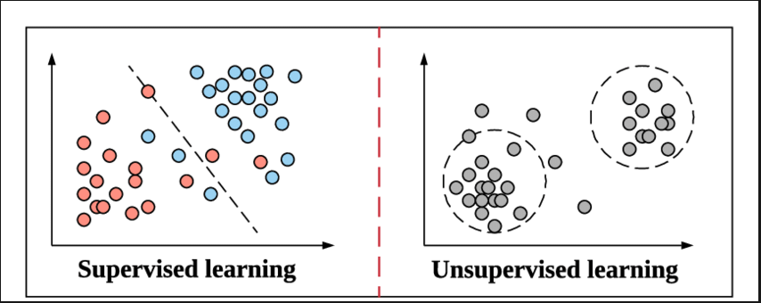
Existing approach
Opinion spamming is becoming more and more of a problem in the e-commerce industry.
Unlike previously, people are now getting paid to post misleading and fake reviews and opinions on products in bulk.
These opinions can be used to market and promote a particular business, spread rumors and damage the reputation of a competing business, or inﬂuence online users’ opinions and views about a particular topic.
It is really hard to detect whether or not a review or opinion is legitimate with the naked eye.
People put in a lot of effort to write realistic fake reviews which makes the problem of detecting them difficult.
Online spam detection is generally considered as a “Classification Problem”.
These methods can be applied when we have a large dataset of labelled reviews including Positive and Deceptive opinions available.
However, it is really challenging to obtain such a dataset in practice.
Labelling of reviews before training is usually done using prior human knowledge which is heavily dependent on subjectivity. This greatly increases probability of mislabeled reviews.
As It is much easier to collect a set of unlabeled data, it is more viable to go with a “Semi-Supervised” or an “Unsupervised” approach.
Methods such as SVM, Decision Trees and KNN are generally used.
6

Slide 7
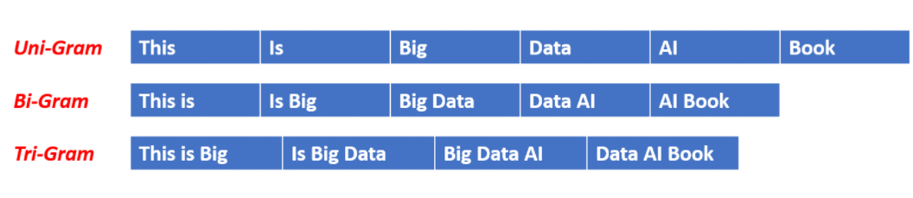
Proposed approach
Review analysis generally depends on 2 things: Review Centric and Reviewer Centric features.
But these features are not the only ones based off which we can decide whether a review is fake or not.
Factors such as “Review Rating” and “Review Sentiment” can be considered as a potential factors.
We can also consider deep text based factors such as “Average Review Length”, “Counts of Emojis” and “FK Score”.
We plan on using all these attributes along with a multitude of ML Models and based off the performance, we will select the best algorithm.
7

Slide 8
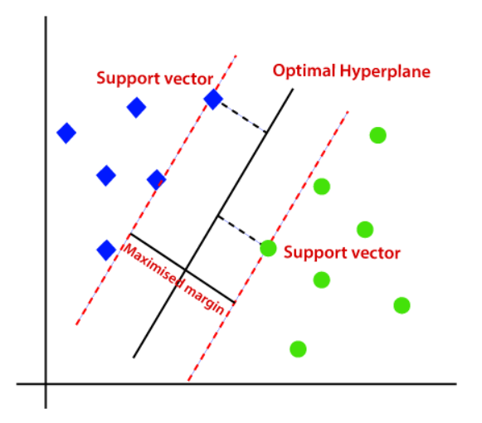
Proposed approach
In this project, we make some classification approaches for detecting fake online reviews, some of which are semi-supervised and others are supervised. For semi-supervised learning, we use Passive Aggressive Classifier.
Statistical Naive Bayes classifier and Support Vector Machines (SVM) are used as classifiers in our research work to improve the performance of classification. We have mainly focused on the content of the review based approaches. As feature we have used word frequency count, sentiment polarity and length of review.
8

Slide 9
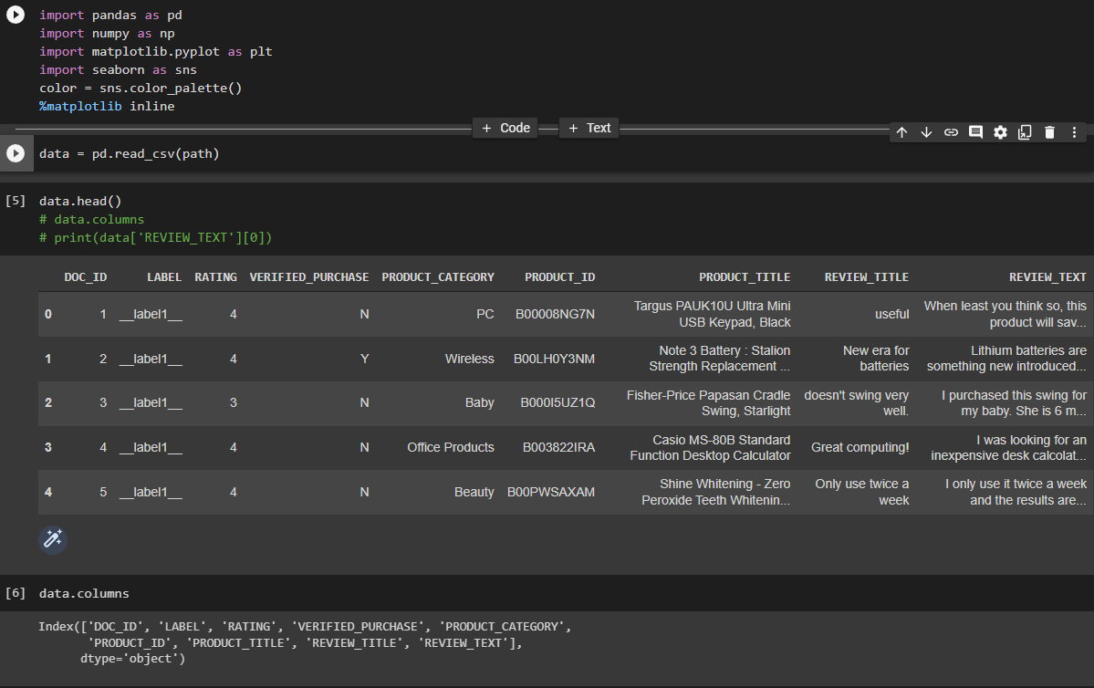
Implementation
As discussed in the Problem Study, those are not the only features can be used to find out whether or not a review is legit or not. In our approach, we found that we can use a few more additional features. Some are:
Review Rating
Emoji Count
Verified Purchase
By using these features along with several Supervised and semi-supervised Machine Learning algorithms, we select the best algorithm to make the model.
We start off by importing our dataset and using pandas to convert it into a DataFrame.
9

Slide 10
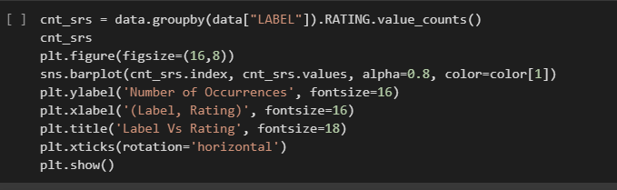
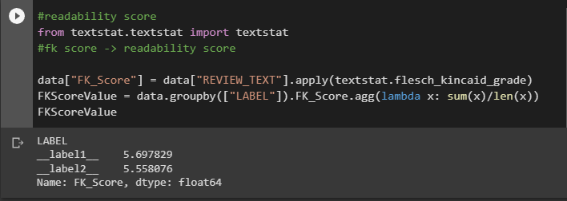
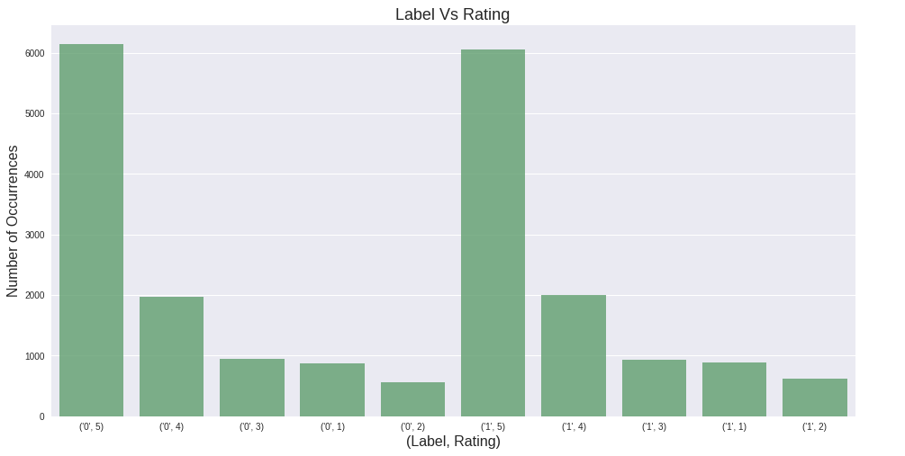
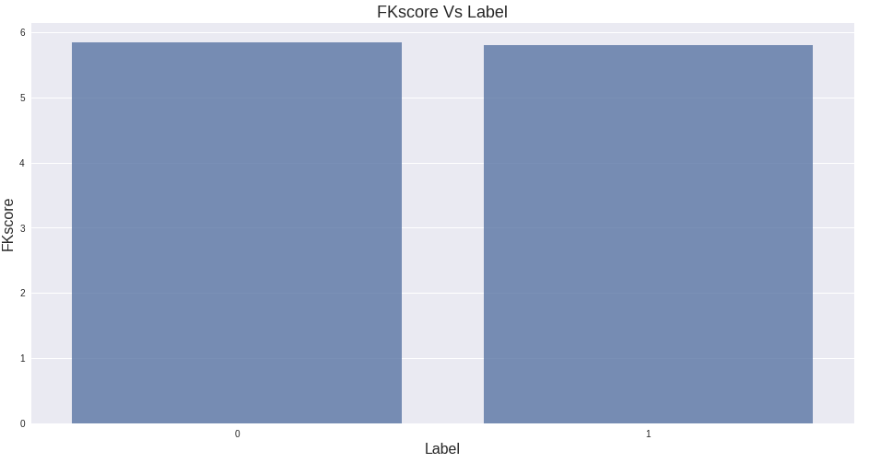
Implementation
In our dataset, we have 21000 Columns (10500 True & 10500 False).
Then we process the data to find out relationships between Review Label and other parameters.
Based on this, we form new attributes which then go into our training.
We then select the columns we need.
Then we apply preprocessing methods on the dataset such as Stop word Cleaning, Lemmatization, Tokenization and Stop Words Tagging.
After this, we apply n-grams to the text. We use CountVectorizer to split the words into BiGrams to perform further analysis.
This is how the text looks after preprocessing.
10

Slide 11
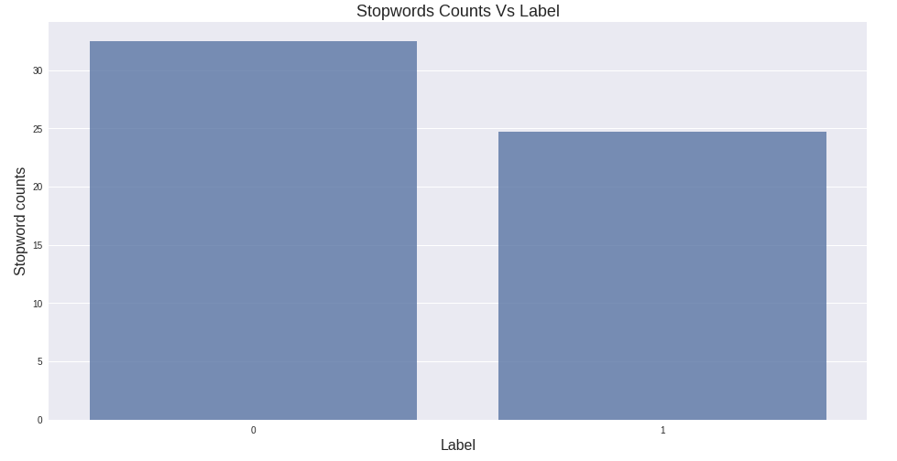
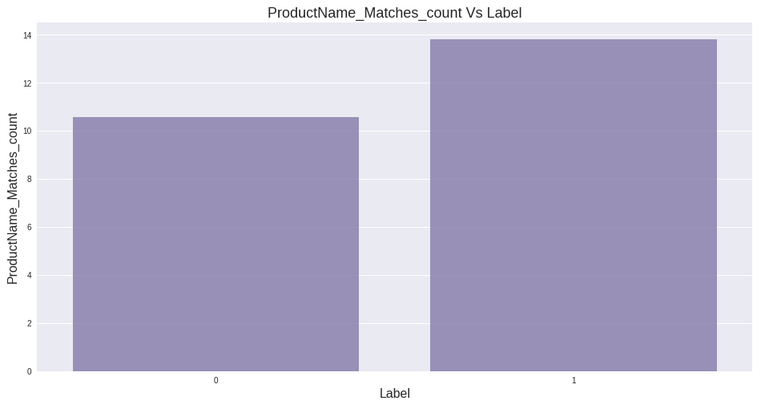
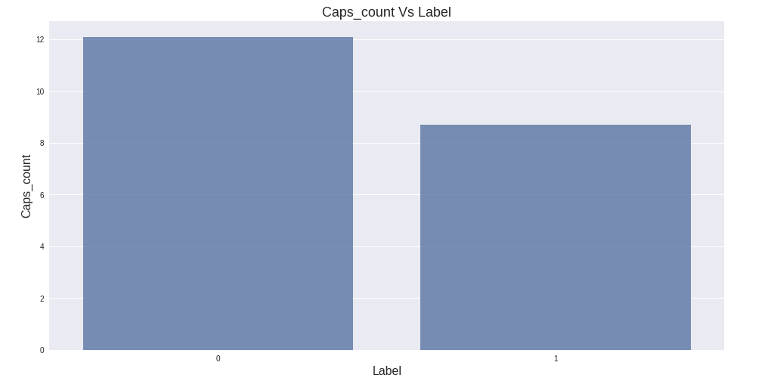
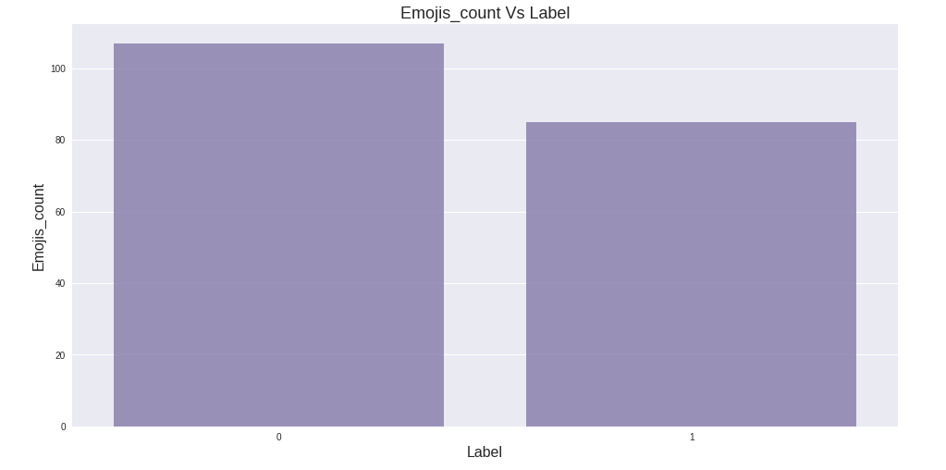
Implementation
11

Slide 12
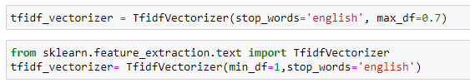

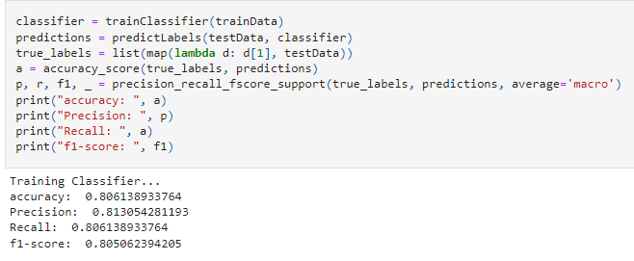


Implementation
After that, we use TF-IDF to rank the words which appear the most frequently. We do this to find out the most used words in fake and real reviews.
We finally use multiple machine learning models and select the best one.
As of now, Passive Aggressive Classifier and SVM gave the best accuracy.
12

Slide 13
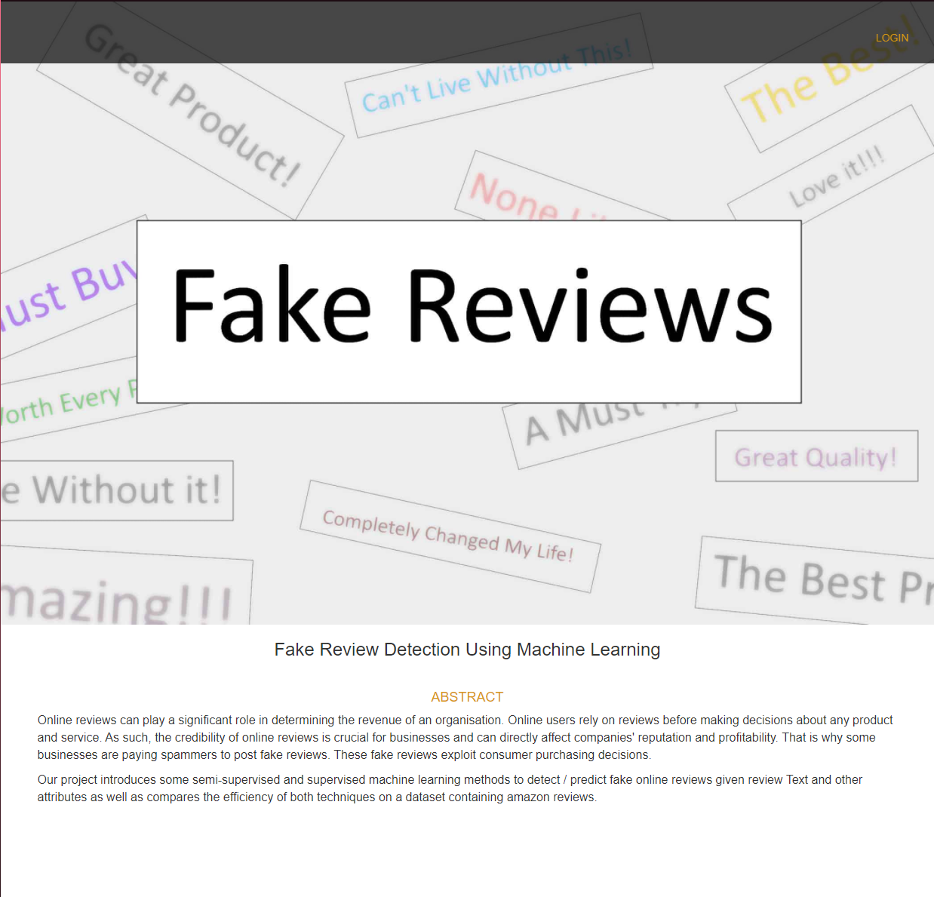

Implementation
13

Slide 14
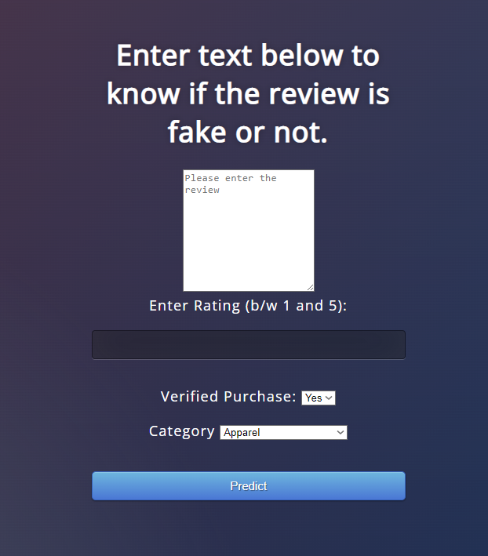
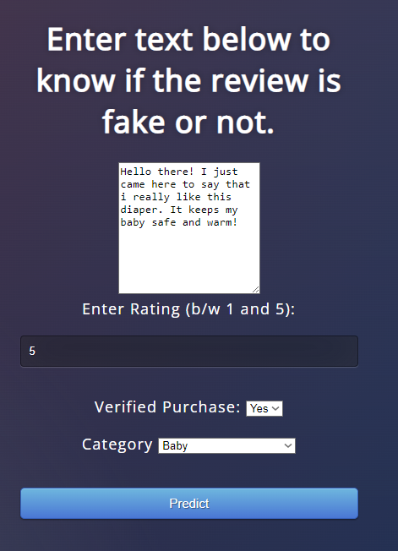
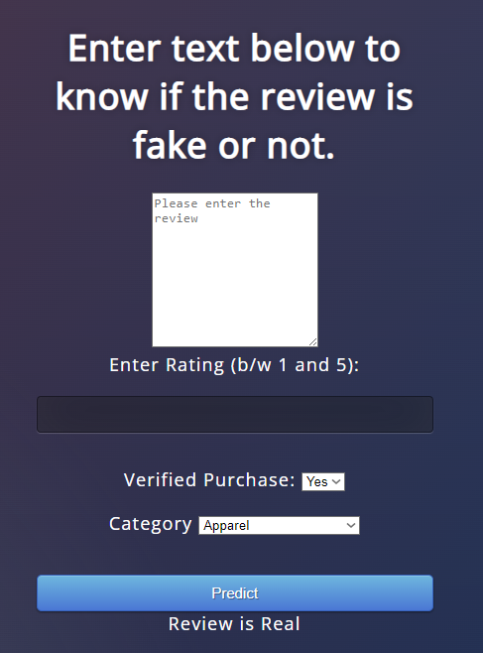
Implementation
14

Slide 15
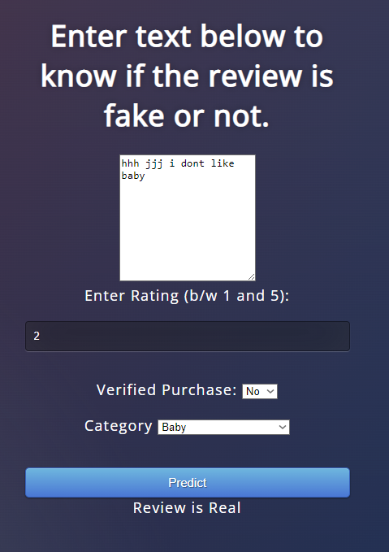
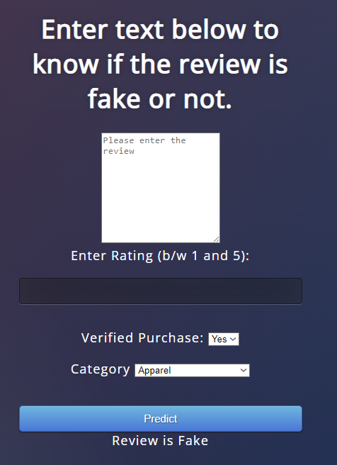
Implementation
15

Slide 16
Modules
MODULE 1: Data Pre-Processing:- We use 1 dataset (Amazon Reviews Dataset). In this step, we Pre-Process our data by applying methods such as Tokenization, Stop Words Cleaning and Lemmatization. After this, we divide our dataset into training and testing. As the dataset suffers from bias, we randomly choose equal-sized fake and non-fake reviews from the dataset and split them into 80% training and 20% Testing.
MODULE 2: Feature Selection:- The next step is to select the relevant features from the Pre-processed data. We use n-gram and TF-IDF along with other feature selection methods such as Gini Index to get the most important and relevant factors.
16

Slide 17
Modules
MODULE 3: Applying Model and Testing Accuracy:- After Pre-Processing our data and getting the attributes and features, we process those features and then test our model. As a low Error rate means higher training and test accuracy, the ML Model which gives us the lowest error is selected.
MODULE 4: User Interface:- In this step, we create the User Interface for the project. It is over here that the user inputs the review and the related data and gets the output.
MODULE 5: Integrating the Modules:- As a final step, we will integrate the model and the User Interface to get the finished product.
17

Slide 18
Contribution
NAME | Roll No. | CONTRIBUTION
Amar Aniketh Varma | 18241A0563 | Coding Research
Vishnu Vardhan Reddy | 18241A0584 | Dataset Research
Mohammed Aftab Ahmed | 18241A0596 | Presentation Documentation References
Sumant Kumar Sharma | 18241A05B2 | Presentation Documentation
18

Slide 19
Conclusion & Future work
In this project, we showed the importance of reviews and how they affect almost every thing related to web based data. It is obvious that reviews play a crucial role in people’s decision. Thus, fake reviews detection is a vivid and ongoing research area. Here, machine learning fake reviews detection approach is presented. In the proposed approach, both the features of the reviews and the behavioural features of the reviewers are considered. The Yelp dataset is used to evaluate the proposed approach. Different classifiers are implemented in the developed approach. The Bi-gram and Trigram language models are used and compared in the developed approach.
Future work may consider including other behavioural features such as features that depend on the frequent times the reviewers do the reviews, the time reviewers take to complete reviews, and how frequent they are submitting positive or negative reviews. It is highly expected that considering more behavioural features will enhance the performance of the presented fake reviews detection approach.
19

Slide 20
References
Anusha Sinha, Nishant Arora, Shipra Singh, Mohita Cheema, Akthar Nazir, “Fake Product Review Monitoring Using Opinion Mining”, International Journal of Pure and Applied Mathematics (IJPAM), Volume 119 No. 12 2018.
Ahmed M. Elmogy , Usman Tariq , Atef Ibrahim, Ammar Mohammed, “Fake Reviews Detection using Supervised Machine Learning”, International Journal of Advanced Computer Science and Applications (IJACSA), Vol. 12, No. 1, 2021.
Swathi Raje, Gouri Patil, “A Machine Learning Model to Predict Fake Review using Classifier on Yelp Dataset”, International Journal of Engineering Research & Technology (IJERT), Vol. 10 Issue 08, August-2021.
Hema Dewangan, Prof. Om Prakash Dewangan, “Opinion Spam Detection, Tools and Techniques : A Review ”, International Journal of Computational Intelligence Research (IJCIR) ISSN 0973-1873 Volume 13, Number 7 (2017).
M. Ott, C. Cardie, and J. Hancock, “Estimating the prevalence of deception in online review communities,” in Proceedings of the 21st International Conference on World Wide Web, pp. 201–210, ACM, 2012.
20

Slide 21
Thank you
21

